Slide 1
Network Security – Basic Concepts
S.Venkatesan

Slide 2
Difference
Firewall | Anti-Virus | Intrusion Detection System |  | Intrusion Prevention System
 |  | Host Based | Network Based | Host Based | Network Based
Only on the packets that are going and coming. | The Process that are running in the machine | The Process that are running in the machine. | The packets that are captured in the network | Prevent the intrusion | Prevent the intrusion
Like a Gateway | Scan files | Policy can be implemented | Policy can be implemented | Policy can be implemented | Policy can be implemented
Works on the packet header | The pattern of the file | Irregularities can be analysed |  | Irregularities can be analysed
Deep Inspection Firewall | Anomaly based anti-virus [Windows Defender] | Patterns, rules, heuristic | Patterns, rules, heuristic | Patterns, rules, heuristic | Patterns, rules, heuristic

Slide 3
Honey Pot Problems
The Internet security is hard
New attacks every day
Our computers are static targets
What should we do?
The more you know about your enemy, the better you can protect yourself
Fake target?

Slide 4
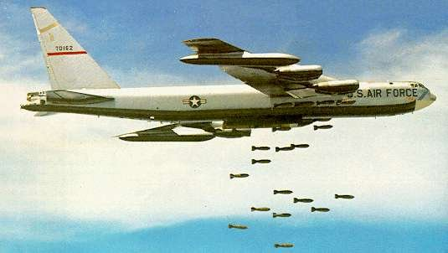
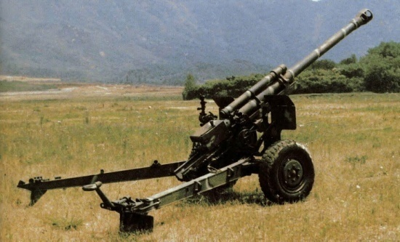
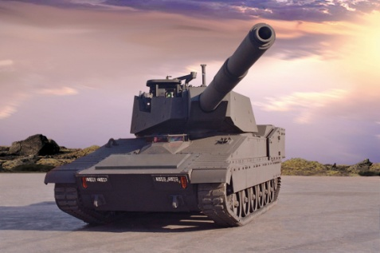
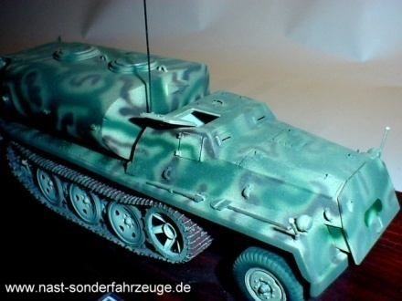
Solutions? Air Attack
Real
Fake
A Detected….

Slide 5
Honeypots?
Fake Target
Collect Infomation

Slide 6
Definition
A honeypot is an information system resource whose value lies in unauthorized or illicit use of that resource.
Has no production value; anything going to/from a honeypot is likely a probe, attack or compromise
Used for monitoring, detecting and analyzing attacks
Does not solve a specific problem. Instead, they are a highly flexible tool with different applications to security.

Slide 7
Classification
By level of interaction
High
Low
Middle?
By Implementation
Virtual
Physical
By purpose
Production
Research

Slide 8
Demilitarized Zone
A DMZ or demilitarized zone is a perimeter network that protects and adds an extra layer of security to an organization’s internal local-area network from untrusted traffic.
The end goal of a demilitarized zone network is to allow an organization to access untrusted networks, such as the internet, while ensuring its private network or LAN remains secure.
Organizations typically store external-facing services and resources, as well as servers for the Domain Name System (DNS), File Transfer Protocol (FTP), mail, proxy, Voice over Internet Protocol (VoIP), and web servers, in the DMZ.

Slide 9
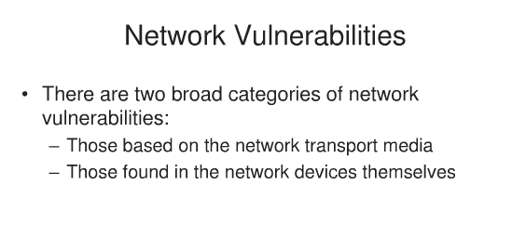

Slide 10
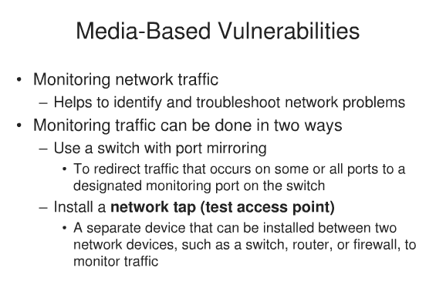

Slide 11
Media Based Vulnerabilities
Port mirroring
Protocol sniffers
Network tap
These can be used to monitor traffic at the same time can be used to steal information.
False ceilings, easy access to add an RJ45
Exposed wiring
Unused rj-45 jacks

Slide 12
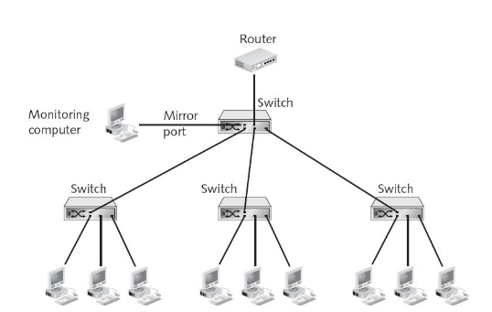
Port Mirroring

Slide 13
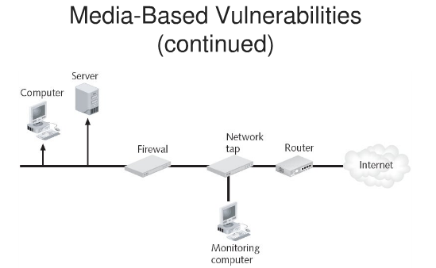
Network Tap

Slide 14
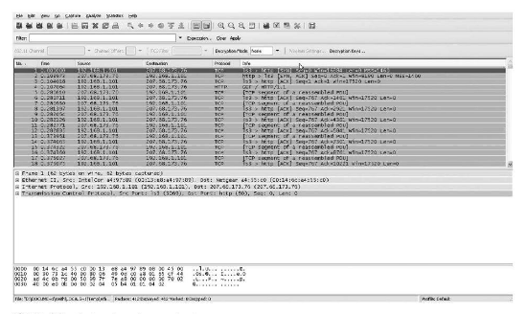
Packet Analyser

Slide 15
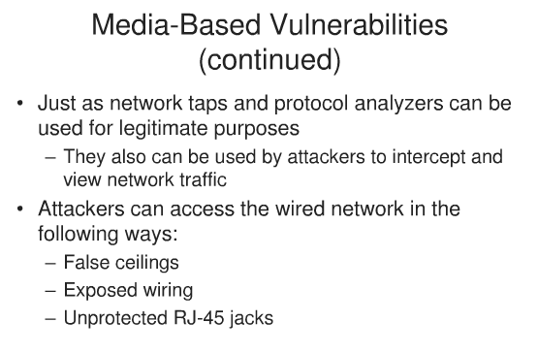

Slide 16
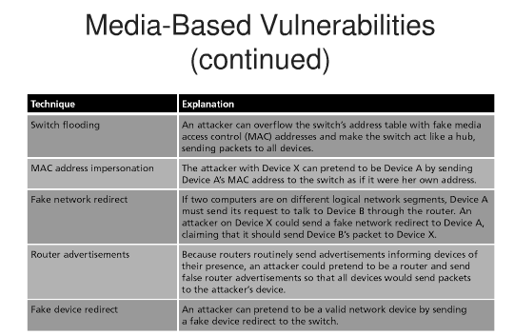

Slide 17
How attacker can see traffic
Switch flooding – then a switch acts like a hub
Mac address impersonation
Fake network redirect
Router advertisements
Fake device redirect

Slide 18
Spoofing
Man in the Middle Attack
Replay Attack
TCP/IP Hijacking
Virtual LAN
Demilitarized Zone
Internet Content Filters
Integrated Security Hardware

Slide 19
Scanning, Filtering and Blocking
Scanning is a systematic process of sweeping through a collection of data looking for a specific pattern
Filtering is a process of using a computer program to stop an Internet browser on a computer from being able to load certain Web pages based upon predetermined criteria such as IP addresses.
Blocking is also a process of preventing certain types of information from being viewed on a computer’s screen or stored on a computer’s disk.

Slide 20
Content Scanning – Pattern-Based
All content coming into or leaving the network, an ISP gateway, or user PC is scanned and checked against a list of patterns, or definitions, supplied and kept up to date by the vendor

Slide 21
Content Scanning – Heuristic
It is done by looking at a section of code and determining what it is doing, then deciding, whether the behavior exhibited by the code is unwanted, harmful like a virus of otherwise malicious.
This approach to scanning is complex because it involves modeling the behavior of code and comparing that abstract model to a rule set.
Because of the checking and cross-checking, this approach takes more time and it is also resource intensive, if not more than the previous one.
Efficient and accurate.

Slide 22
Inclusion Filtering
It is based on the existence of an inclusion list.
The inclusion list is a permitted access list – a “white list” probably vetted and compiled by a third party.
Anything is on this list is allowable.
The list could be a list of URL for allowable Web sites, for example it could be a list of allowable words, or it could be a list of allowable packet signatures for allowable packets.
Drawbacks
Difficulty to come up with a globally accepted set of criteria.
Size of inclusion list.
Difficulty of finding a central authority to manage the list. (CERT)

Slide 23
Exclusion Filtering
It is opposite to Inclusion filtering
An exclusion list is actually a “black list” of all unwanted, objectionable, and harmful content.
The list may contain URLs of sites, words , signatures of packets, and patterns of words and phrases.
It is good compare to the previous one because it does not pre-assume that everything is base until proven otherwise.
However, it suffers from a list that may lack constant updates and a list that is not comprehensive enough.
With respect to virus, no one is having the list of all known virus signatures.

Slide 24
Other types of Content Filtering
URL Filtering
It is the most popular form of content filtering, especially in terms of denial of access to the targeted site.
One of the advantages of URL filtering is its ability to discriminate and carefully choose a site but leave the IP address of the machine that hosts functioning and, therefore, providing other services to the network or PC.

Slide 25
Keyword Filtering
It requires that all the inbound or outbound content be scanned, and every syntactically correct word scanned is compared with words either on the inclusive – white list or exclusive black list depending on the filtering regime used.
Drawbacks
Text based only not on image
Only Syntactic not Semantic

Slide 26
Packet Filtering
It will scan the packet (IP addresses)
This kind of blocking is indiscriminate because it blocks a machine based on its addresses, not content, which means that a machine may have other good services but they are all blocked.

Slide 27
Profile Filtering
The use of artificial intelligence in content filtering is resulting into a new brand of content filters based on the characteristics of the text “ seen” so far and the learning cycles “repeats” done to discriminate all further text from this source.
Because of the complexity of the process and the time involved and needed for the filter to “ learn”, this method, so far, has not gained popularity.
It will take some time to do pre processing (Learn).

Slide 28
Image Analysis Filtering
Image based Scanning
This approach is facing lot of problems of pre-loading images for analysis, high bandwidth making it extremely slow, and syntactic filtering making it indiscriminate semantically.

Slide 29
Location of Content Filters
PC
Server
ISP
Third Party

Slide 30
Filtering on the End User’s Computer
At this location, the user is the master of his or her destiny.
Using software installed on the user machine, the user can set blocking rules and blocking lists that are expressive of his or her likes and dislikes

Slide 31
Filtering at the ISP’s Computer
Filtering is done at the ISP level
This is a centralized filtering, it has several advantages over others.
First it offers more security because the ISP can make more resources available than the user would.
The ISP can dedicate complete machines- called proxy servers, to do the filtering, thus freeing other machines and making the process faster.
ISP can have more detailed lists and databases of these lists than a user.

Slide 32
Filtering by Organizational Server
Filtering is done at the server level
Like ISP filtering this is centralized filtering and it offers a high degree of security because the filtering rules and lists are centrally controlled.

Slide 33
Filtering by a Third Party
Like ISP or dedicated servers in the organization.

Slide 34
Virus Filtering
A computer virus is a self-propagating computer program designed to alter or destroy a computer system resources.

Slide 35
Virus Infection/ Penetration
Boot sector
Macros Penetration
Parasites
Blaster Viruses

Slide 36
WLAN Traffic Segmentation
Firewalls
Routers
VPN
VLAN

Slide 37
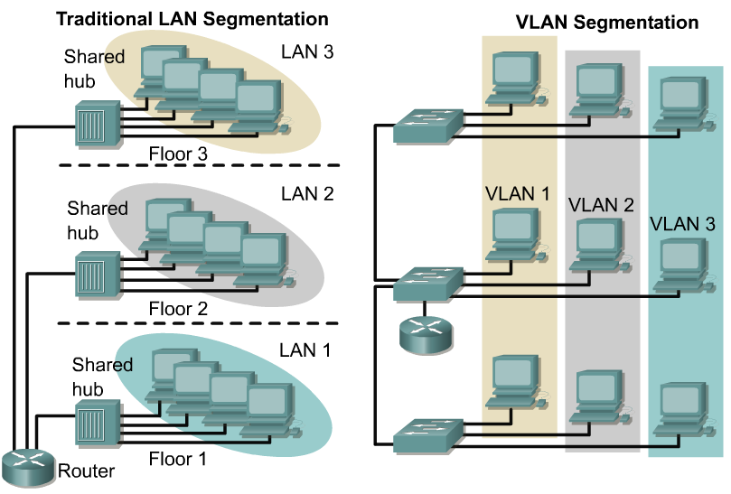
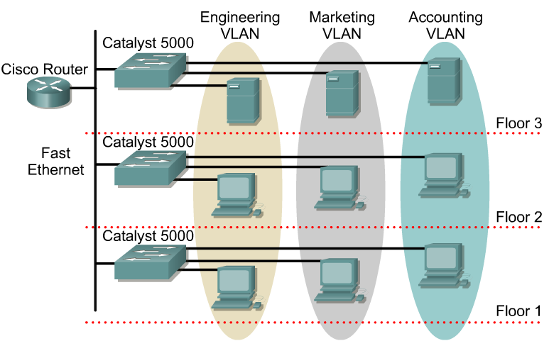
VLAN based segmentation

Slide 38
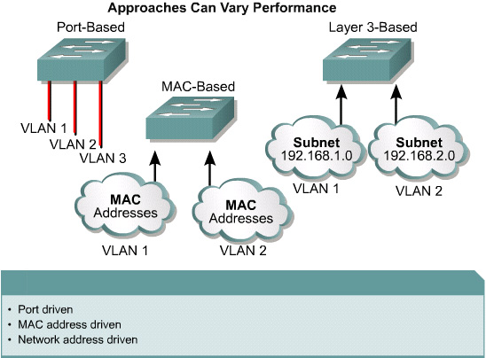
VLAN types

